Slide 1
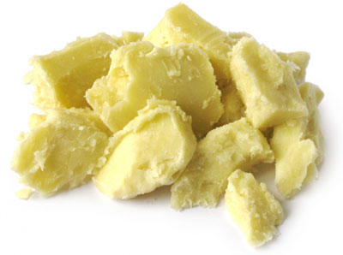
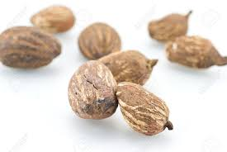
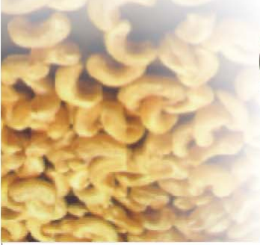

GHANA NUTS COMPANY LIMITED
Our Business FOCUS

Slide 2
OUR BACKGROUND
Ghana Nuts Company Ltd, located in Techiman in the Brong -Ahafo Region has been in existence since 2001.
The company is a major player in the shea nuts industry with current annual shea nuts crushing capacity of over 90,000 metric tons. With all of its total crude shea butter output going for export.
Ghana Nuts also has a 35,000 tons per annum soya bean capacity plant and a 70 tons per day refinery plant.
The company currently employs over three hundred and fifty (350) direct labour force and over a thousand (1000) indirect workers for both the shea nuts and the soya bean value chains.

Slide 3
Where we are & what we aim to achieve
  Currently:
  We produce high quality shea butter for export globally.
  The company has a very heavy presence in Europe and some countries in Asia.
  The current crushing capacity is 200 tons per day.
  In the very near future we aim to:
  Expand our crashing capacity to respond to our increasing client base, steady growth and portfolio.
  Gain competitive advantage over our competitors through high quality products and competitive pricing.
  Improve customer loyalty by responding favorably to anticipated growth expectations of the future.
  Command more respect and appreciation from our already satisfied clients.

Slide 4
OUR VISION
Is to supply high quality shea butter
and it’s byproducts to our clients
throughout the world.
We are working to operate with unparalleled professionalism, hard work and dedication.
We wish to become our customers’ first choice
in both service and quality.

Slide 5
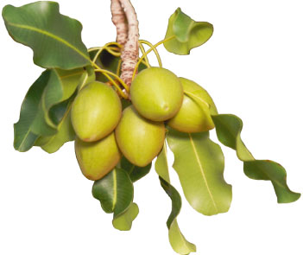
The product (Shea Nuts)

Slide 6
The product (Shea Nuts) cont’d
We have a crushing capacity of 300 metric tonnes per day enabling us to produce about 150 metric tonnes of shea butter daily.
Our state-of-the-art technology enables us to produce high quality crude shea butter that meets international standards.
GNL has crude shea butter storage capacity of over 500 metric tonnes in the factory.

Slide 7
The product (Shea Nuts) cont’d
General product specifications:
Crude Shea Butter
  FFA: 10% Max
  Moisture: 0.1% Max
  Impurities: 0.2% Max

Slide 8
OUR BUSINESS ATTIBUTES
International Certifications
Some of the international certifications won by GNL include:
Kosher &
Halal

Slide 9
OUR BUSINESS ATTIBUTES
Some of our major international clients include:
Food
Cosmetics
  AAK, Denmark
  Bunge Loders Croklaan BV
  Jan Duel Management, Netherland
  OLVEA, Netherland
  Gustav Hees GMBH, Germany

Slide 10
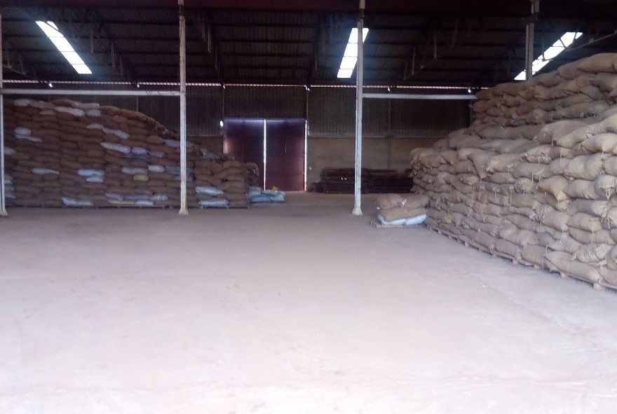
OUR plant
One of our warehouses:
Capacity to store 15,000 metric tonnes of shea nuts
Very spacious, well enclosed, ventilated and fumigated with food grade chemicals to keep rodents and other pests out.
Well designed and constructed to enable easy loading and discharge of raw materials
With electrical feeding and input system which delivers shea nuts directly to the seeds cleaner and then to the cleaned nuts storage tank.

Slide 11
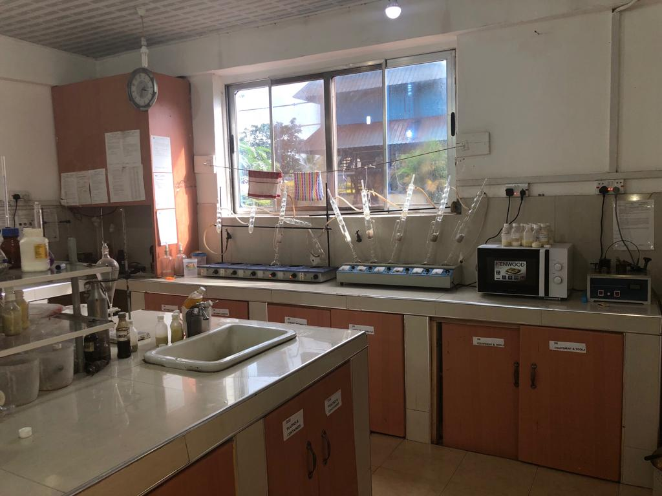
OUR plant
Our state of the art laboratory
Equiped with modern analytical instruments
Performs continuous process analysis non-stop
Well qualified, trained, dedicated and motivated laboratory personnel.

Slide 12
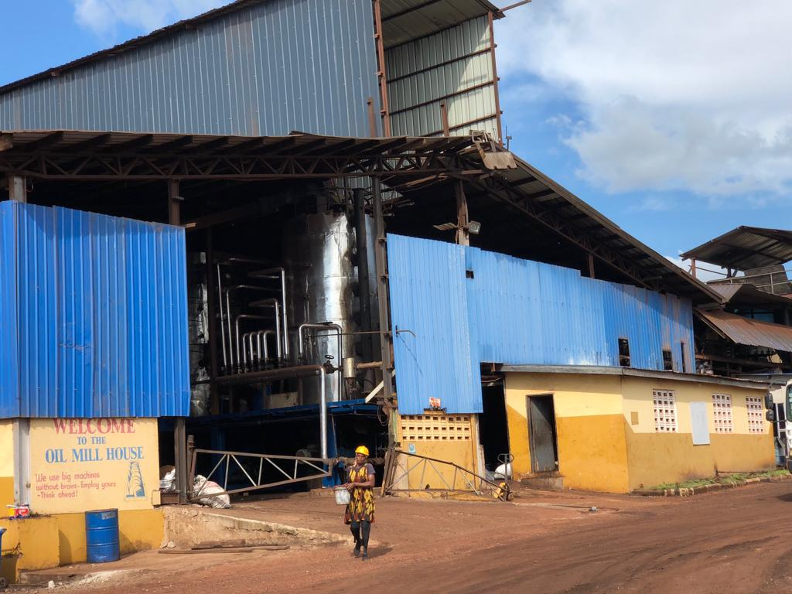
OUR plant
With modern state of the art equipment.
Capable of processing about 300 metric tonnes of shea nuts per day.
Manned by well trained, dedicated and motivated personnel.
Our Oil Mill

Slide 13
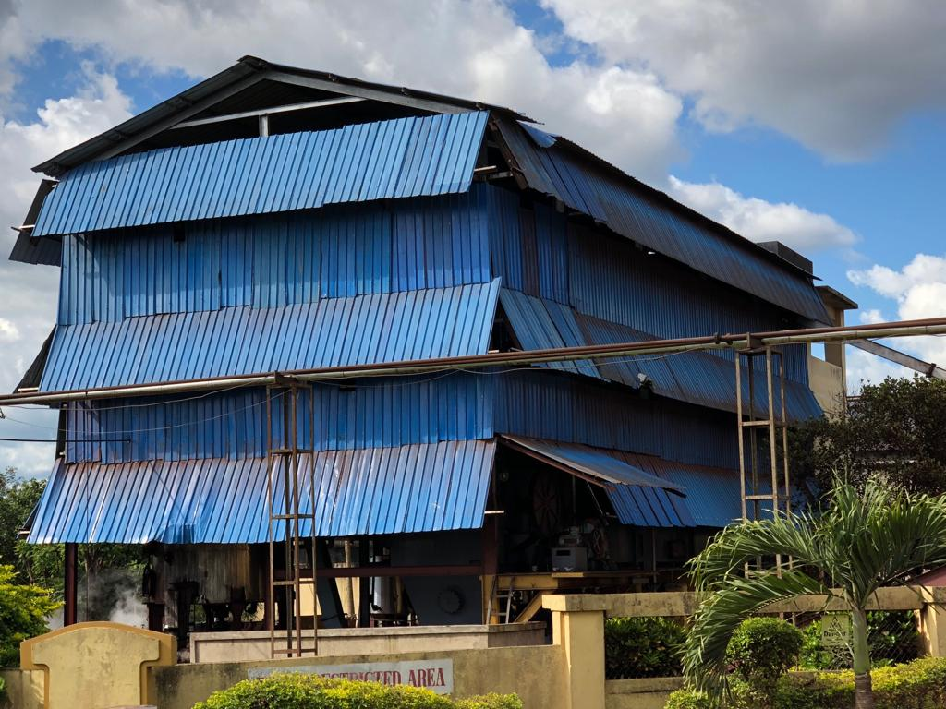
OUR plant
Our solvent extraction plant
Modern state of the art equipment.
Uses food grade Hexane to extract shea oil from pressed shea cake.

Slide 14
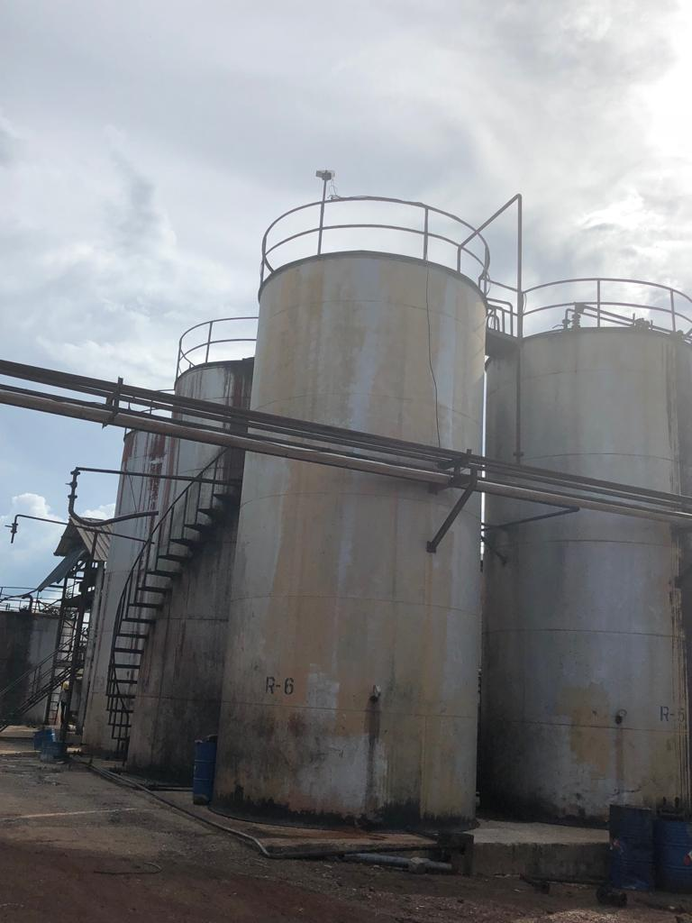
OUR plant
Capable of storing over 1,000 metric tonnes of crude shea butter.
In-Built hot water/steam heating coils for maintaining the right temperatures for storage and dispatch.
Segregation of butter, based on customer requirements.
Appropriate pumping system for loading into bulk tank trucks, iso tanks and flexi bags amoung others.
Crude Butter storage tanks

Slide 15
OUR competencies
Keeping the competition in check.
To survive in the fierce international shea market to deliver quality products at lower prices, GNL is vigorously pursuing the following programs:
Statistical Quality Control,
Practice Ahead of time/ Just-in-time Production schedules,
Worker Training: With (in-house) or outsourced research personnel with the necessary expertise and qualification to boot.
Flexible Manufacturing Systems
Planning of Materials Required

Slide 16
price strategies
Sales prices of our products and by-products are dynamic.
The prices are based on several factors. eg raw material costs and customer specifications
Prices are fixed. The company does not reduce the prices of its products.
We give our clients the best quality products at the lowest prices.

Slide 17
Why our clients choose us
Nearness to raw materials
Our assurance of the highest quality that suit client specifications
Our use of state of the art facilities, ensuring high efficiency
Our prices are highly competitive

